Slide 1
Question
What’s the MH10.8.12 solution to marking small packages?

Slide 2
Micro Mark
We request a reduction in the 2D matrix cell size to accommodate smaller integrated circuit package types down to 2x2mm DFN.
The goal of marking and reading semiconductor packages is to allow for more efficient means to track, authenticate, and inventory semiconductor devices.
This goal can be attained today with readily available technology, though the MH10.8.12 standard currently does not allow for these smaller marks.

Slide 3

Micro Mark 2D Code Scaling
7.5X
Reduction!
Micro Mark
MIL-STD-130M
Symbol Size | Data Capacity | MIL-STD-130M | Micro Mark
 |  | 7.5 mil Cell | 1 mil Cell
10 x 10 | 6 | 1.9 mm | 0.25 mm
12 x 12 | 10 | 2.3 mm | 0.30 mm
16 x 16 | 24 | 3.0 mm | 0.41 mm
20 x 20 | 44 | 3.8 mm | 0.51 mm
22 x 22 | 60 | 4.2 mm | 0.56 mm
Target mark capacity leverages foundation of the CEA-706 standard

Slide 4
2D Mark Position Specifications
2mm
Mark features:
22 x 22 2D matrix
IC Package
9CT
Θ <= 10 degrees
SS
2mm
0.55mm
(22mil)
22 x 22
2D
Matrix
0.55mm
(22mil)
0.15mm ± 0.025mm
(6mil ± 1mil)
0.15mm ± 0.025mm
(6mil ± 1mil)

Slide 5
2D Mark Specifications
0.56mm
Mark features:
22 x 22 2D matrix
25um (1 mil) cell size
25um (1mil) cell pitch
0.56mm
25um
(1mil)
25um
(1mil)

Slide 6
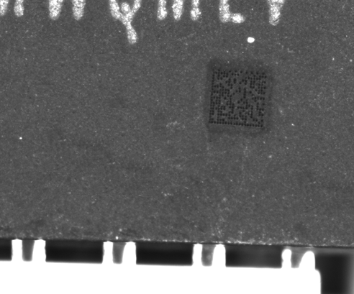
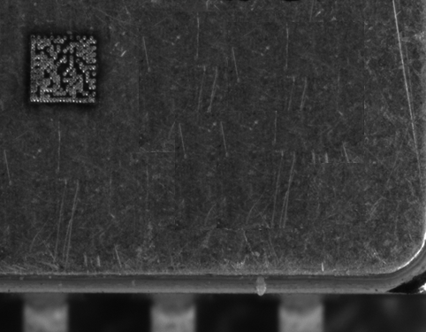
Marking Examples
1 mm
1 mm
Plastic
20 x 20 Matrix
Ceramic
20 x 20 Matrix
Metal
20 x 20 Matrix
Laser system capable of creating readable marks on the three most widely available semiconductor packaging materials.

Slide 7
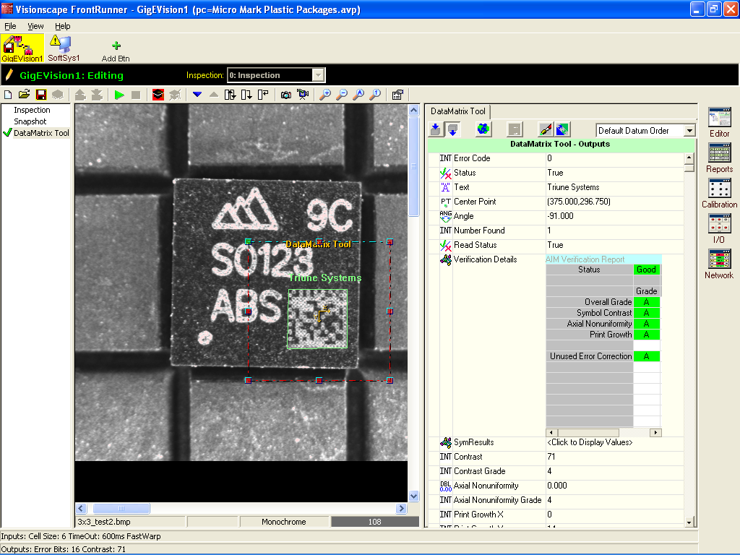
Reading Example
Laser Marker
Photo taken on a production semiconductor manufacturing handler system (Ismeca NX16) yielded excellent reading results.

Slide 8
Micro Mark
Triune Systems is proposing a slight but impactful revision to the MH10.8.12 standard, allowing for smaller marks for smaller items.
Thank you for your time and consideration

